Slide 1





Cloud-Based Data Analytics for Public Food Distribution System
GUIDED BY : PRATHYUSHA

Slide 2

Introduction
“Public Distribution Systems are government-managed programs designed to provide essential food grains such as rice and wheat to eligible beneficiaries at subsidized rates.
Many states have digitized these systems using mobile apps and portals. However, most existing systems mainly focus on data storage and monitoring. They show what has already happened, but they do not actively predict future demand or optimize supply planning.
This project aims to enhance such systems by introducing cloud-based data analytics and predictive modeling.”

Slide 3
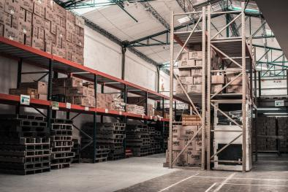
ABOUT
“T Ration app is the official Public Distribution System application . It enables citizens to check ration card details, allocation status, and shop information.
It also allows government officials to monitor distribution records and manage beneficiary databases.”
Official PDS app of Telangana.
Digital Beneficiary Verification
Monthly Quota Validation
Manages ration card and beneficiary data
Tracks food grain allocation
Provides transparency in distribution
Supports citizens and officials

Slide 4
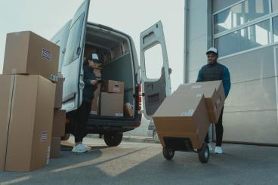
Problem Identification
“The current system operates reactively. It shows past data but does not forecast future demand. Without predictive analytics, there may be regional shortages or excess stock. There is no intelligent analytics layer to support proactive planning.”
• Reactive planning
• No demand forecasting
• Possible shortages/overstock
• No analytics layer
• Limited decision support

Slide 5
new features using cloud data analytics
Demand forecasting engine
Smart stock allocation system
Real-time inventory tracking
AI-based fraud detection
Geo-analytics heatmap dashboard
Predictive shortage alerts
Automated anomaly detection
Beneficiary behavior analytics
Seasonal consumption analysis
Real-time SMS & app alerts
Performance analytics for fair price shops
AI-based complaint pattern analysis
Cloud-based disaster demand planning

Slide 6
Project Objective
“The main objective of this project is to integrate a cloud-based analytics layer into the existing system. The goal is to predict food demand, improve allocation efficiency, and support data-driven governance.”
Goal: Add Cloud-Based Predictive Analytics
• Forecast demand
• Improve allocation
• Reduce wastage
• Enable data-driven decisions

Slide 7

Data Used
Data Sources for Analytics
• District Distribution Records :
how much food grain, such as rice or wheat, is distributed in each district every month.
• Monthly Allocation Data:
How much quantity of food allocated to each district or ration shop.
we can identify gaps, excess supply, or shortages.
• Beneficiary Counts:
This includes the number of active ration card holders and family members linked to each card. This data helps in estimating demand based on population size and eligibility category.

Slide 8
Data Used
• Shop Transaction Logs:
These logs contain detailed transaction records such as date of distribution, quantity issued, and authentication details.
• Historical Trends:
This includes past year distribution patterns, seasonal variations, and festival-related demand changes.

Slide 9
How Does This Data Help in Forecasting
The historical monthly distribution data is used as time-series input.
Beneficiary count acts as a demand baseline.
Seasonal patterns are identified using trend analysis.
These variables are then used in forecasting models such as linear regression or ARIMA to estimate future food grain requirements.

Slide 10
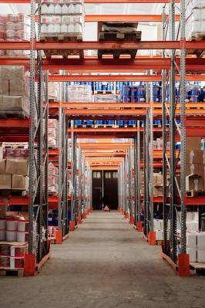
Role of Cloud in the System
• Centralized Storage:
ensures that all beneficiary data, allocation records, and transaction logs from multiple districts are stored in a unified cloud database.
• Scalability:
allows the system to handle increasing data volumes. the cloud infrastructure can dynamically expand storage and computing resources without requiring physical hardware upgrades.
• Real-Time Processing:
enables continuous data updates. When a ration transaction occurs at a fair price shop, the data can be uploaded instantly to the cloud. This supports live dashboards and immediate analytics.
• Secure Access:
handles sensitive beneficiary information.

Slide 11
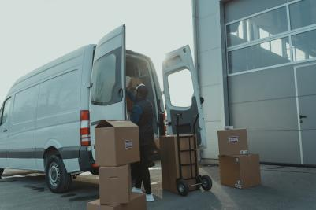
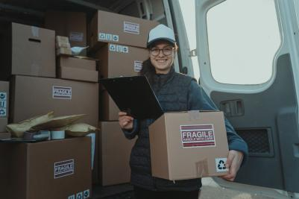
Analytics Techniques
• Descriptive analytics
• Trend analysis
• Time series forecasting
• Anomaly detection

Slide 12
Improvement Over Existing System
System Transformation
Current → Monitoring System
Proposed → Predictive & Intelligent System
• Shortage Alerts
• Smart Allocation
• Reduced Wastage
• Better Planning

Slide 13
How the Improved T Ration System Helps Needy People
Ensures Availability of Ration
Prevents Diversion and Fraud
Improves Fairness and Transparency
Reduces Waiting Time and Confusion
Provides Early Alerts
Supports People During Emergencies(floods)
Enables Data-Driven Policy Decisions
Faster Grievance Resolution

Slide 14
THANK YOU

